Slide 1
Diplodocus Team Pronounced: duh·plaa·duh·kuhs
Alfonso Camero
KC Oh
Marie Prosper

Slide 2
Project Description
Since its inception in 2008, Airbnb has disrupted the traditional hospitality industry as more travelers decide to use Airbnb as their primary means of accommodation. Airbnb offers travelers a more unique and personalized way of accommodation and experience.
This dataset has one file- airbnb_data.csv
This dataset contain information on Airbnb listing across the United States and we tried to analyze the data.

Slide 3
Project Questions
What are we trying to solve? Independent/Dependent variables
How does population affect the variables included in the dataset?
Are there any clear relationships between some of the variables?
Dataset
Csv file: airbnb_data.csv
url = f'http://public.opendatasoft.com/api/records/1.0/search/?dataset=cities-and-towns-of-the-united-states%40public&q={city}&facet=name&facet=state&refine.name={City}&refine.state={state}'

Slide 4
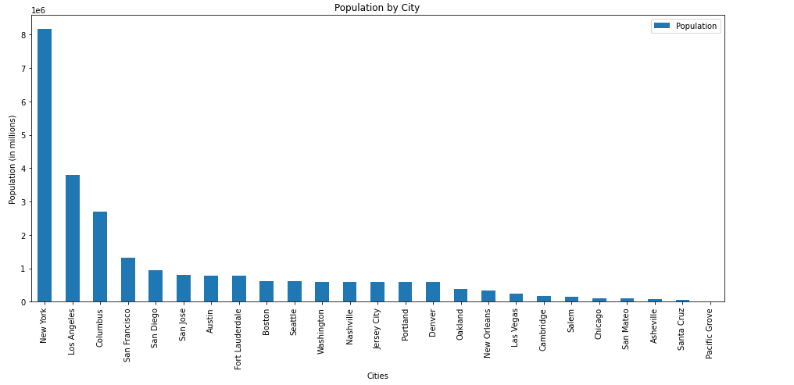
Population by City

Slide 5
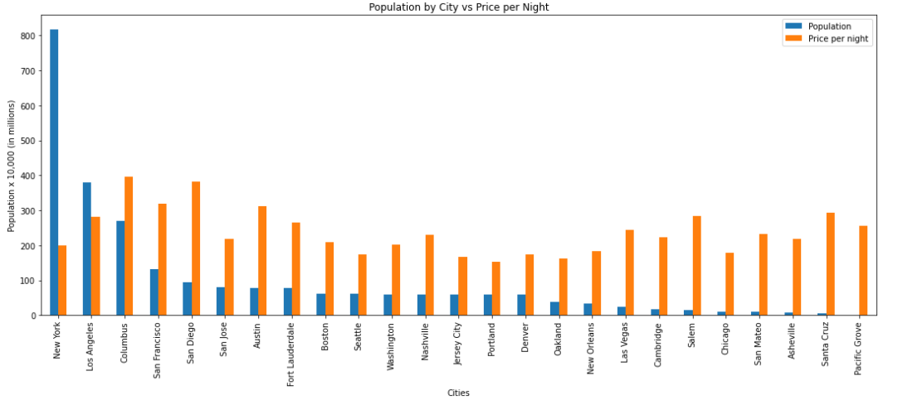
Population by City vs. Price per Night

Slide 6
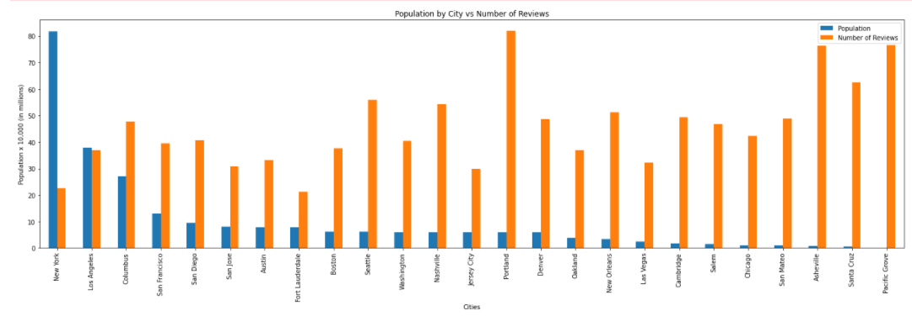
Population by City vs. Number of Reviews

Slide 7
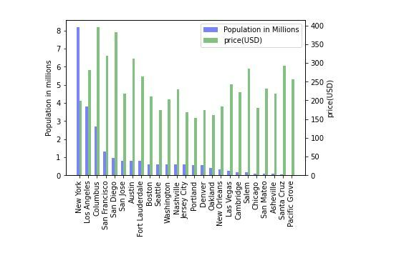
Population by City vs. Listing per City

Slide 8
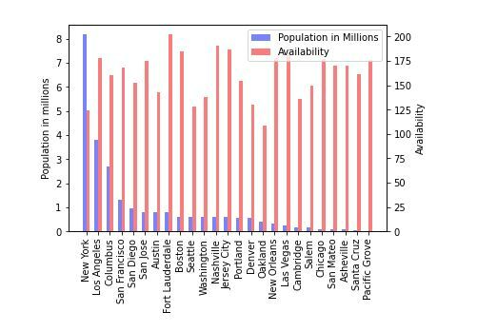
Population by City vs. Availability

Slide 9
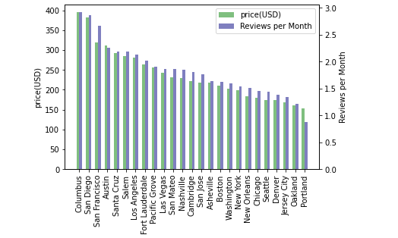
Price per Night vs. Number of Reviews

Slide 10
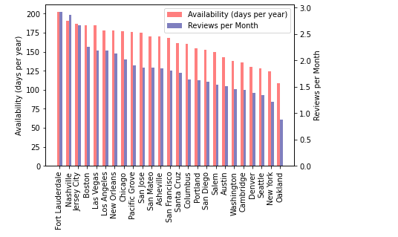
Availability (days per year) vs. Reviews per Month

Slide 11
Breakdown of Tasks
Marie Prosper
Project manager, proposal, presentations, box plots(not used)
Alfonso Camero
Bar graphs
KC Oh
Bar Graphs

